Slide 1

GTC Ignite Security & NextGen Present
OWASP Top Ten Workshops
A3 Cross-site Scripting
Alec-Angus Macdonald
go/alec
Notes:
Introduce me – not an expert by any means. I’m a Developer and ASC for EDPI
This is the third in a series from the Ignite Security group. Also sponsored by the NextGen Business Resource Group who are looking to connect young professionals and mentors – give them a shout if that’s something you think you can help with.
OWASP is the Open Web Applications Security Project and our interest with them is that every five years or so they release what they regard as the Top Ten threats to Web Application Security.
So today it’s my great pleasure to introduce you to what they’re regarding is the third biggest threat facing software today...

Slide 2
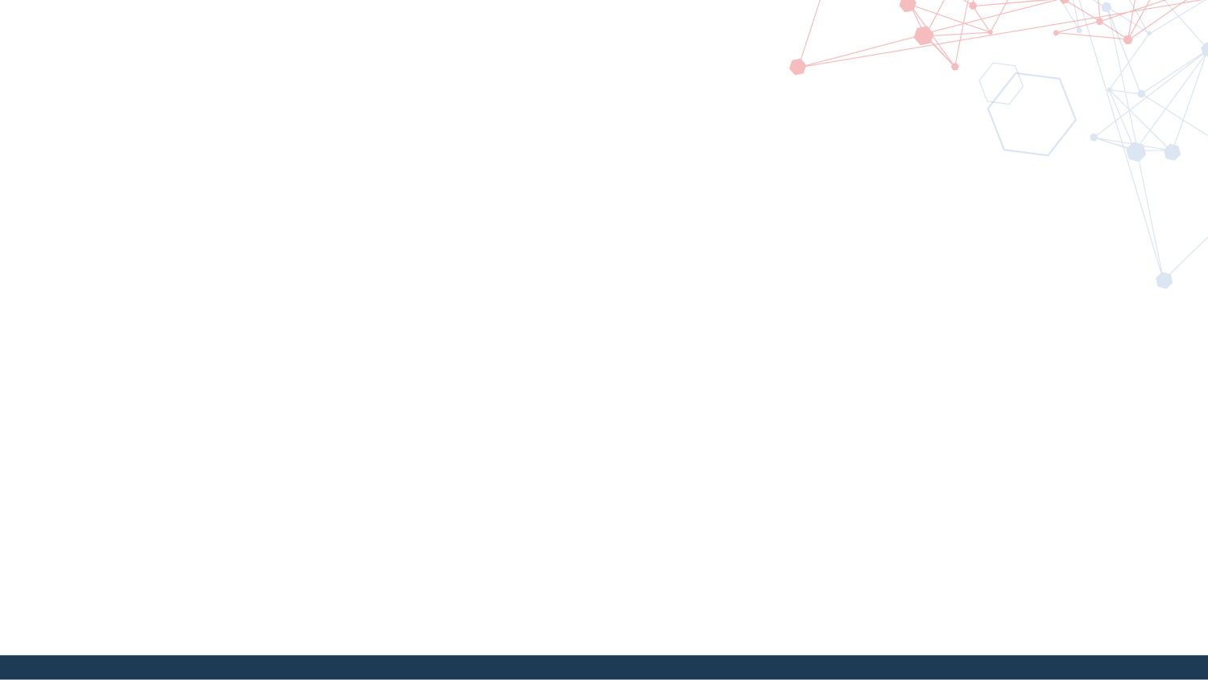
What is XSS?
Cross-site Scripting
“...a type of injection, in which malicious scripts are injected into otherwise benign and trusted web sites”
Why does this happen?!
Notes:
If you cast your mind back to the first in this series where Sean introduced us to SQL Injections, this is the same except this time it’s markup and javascript being injected rather than SQL.
This is called Cross Site Scripting.
<read the slide>
The root cause is exactly the same as the SQL injection – the browser engine responsible for interpreting doesn’t have enough information to allow it to tell the good code apart from the bad code.
Also, there’s no notion of elevated privilege so it has to assume that it can grant access to cookies, session data and other sensitive data to all who ask unless told otherwise because it needs this stuff to operate – for instance, logging in and maintaining a session.

Slide 3

Live demo?
Notes:
So what does this actually look like in the wild?
Just to wash my hands a little bit, what I’m about to try to show you has already been disclosed and I did quickly run it past Sean this morning (extremely broadly and briefly so as not to throw him under the bus)
In the next slide I’m going to tell you how ubiquitous cross site scripting vulnerabilites are… and it turns out that (fingers crossed) that jpmorgan.com is vulnerable too
https://www.jpmorgan.com/jwplayer/player.swf?playerready=function(){window.location="https://www.jpmorgan.com";}&debug=function(){alert(/Alecs XSS Demo/);alert(document.domain);alert(document.cookie);}
~/Documents/xss/scripts/harlem.js

Slide 4
What’s the big deal?
Widespread
Dangerous:
Redirect to a phishing site
Steal cookie information
Force the user to make an action he's unaware of
Hook the user's browser
Change the information the user is seeing
Just break the site
Notes:
You’ll be glad to hear we’re in good company.
Because of the nature of the attack vector, it’s a massively widespread problem
In fact, Whitehat Security released a study that stated that more than 1 in every 2 websites currently have live XSS vulnerabilities.
So from the demo, you might be thinking “Ok, but so what?”. I exposed my own cookie and made the page I loaded dance but that PoC shows it could have been so much worse…
<talk through the slide>

Slide 5
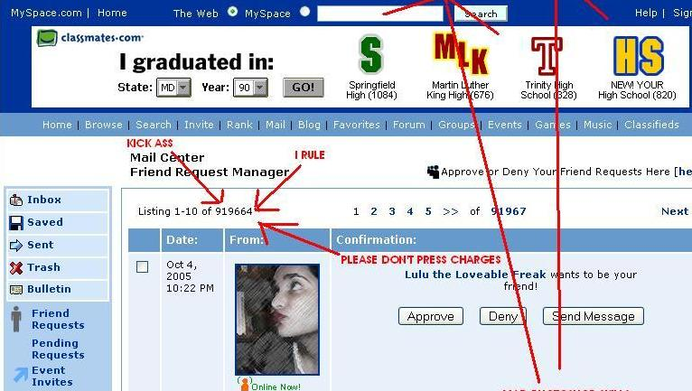
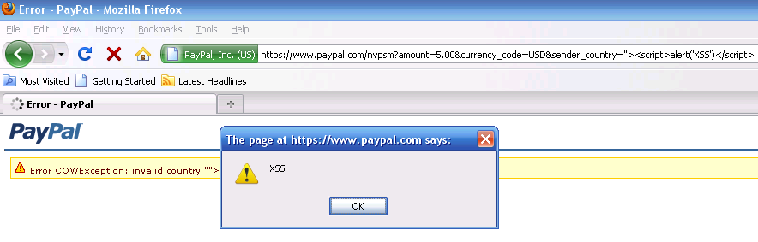
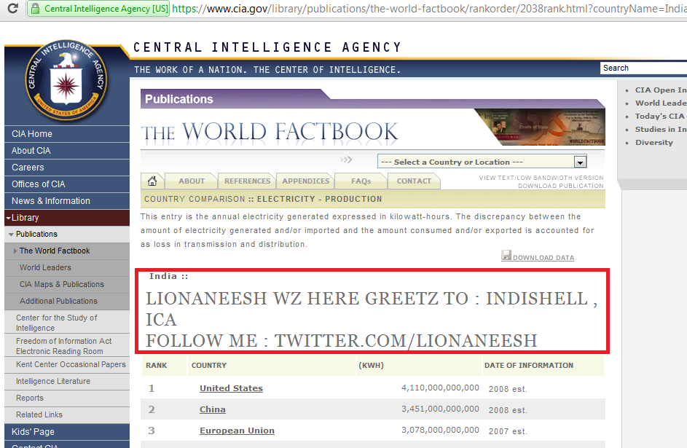
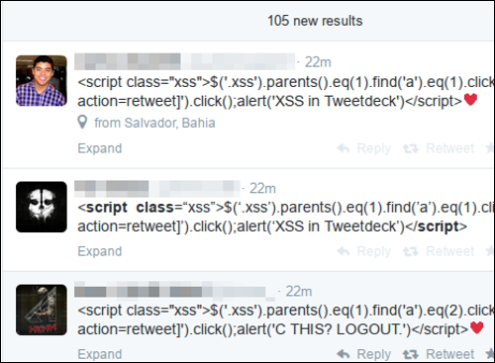
Examples in the wild
Notes:
Examples everywhere
Myspace, Samy, 2005
Paypal, Reflected 2010
CIA.gov, Persisted 2011
Twitter, Persisted 2014
This is just to show that this is an age old problem, and one that we’re not getting much better at yet. Websites are getting ever more complex and the attack landscape is increasing with it.

Slide 6
Bookwork
Client-side XSS (Reflected)
Server-side XSS (Stored)
Notes:
Fundamentally there are two distinct types of attack.
The first is where a user is tricked into attacking himself unaware, bouncing an attack off the vulnerable website and having a payload run that way.
The second is where the user goes to a website and the site is already compromised, with the attack lying in wait.
In the first the attack payload comes from the client and in the latter it comes from the server.

Slide 7
Client-side XSS (Reflected)
http://go/jpm
https://www.jpmorgan.com/index.html?name=Chris<script>alert(document.cookie)</script>
Notes:
In a client side attack, if we assume I’m the attacker and I’m targeting a JP Morgan employee.
<talk through the slide>
To note, this attack requires an element of social engineering – it relies on my target clicking the initial link.

Slide 8
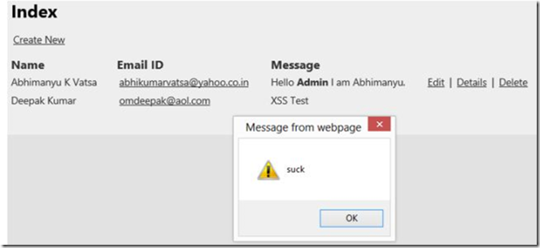
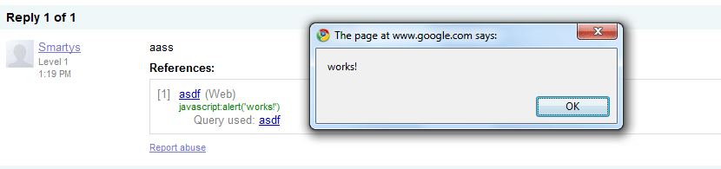
Server-side XSS (Persistent)
Notes:
Serverside attacks are more broad spectrum – this is where the attacker has been able to store his script injection into the database such that every time the page with that information loads, the payload runs too.
Every single person who visits that page will be exposed to that attack.

Slide 9
What to do about it?
Trust no-one
Restrict and Validate sinks (inputs)
Encode sources (outputs)
http://go/stk
Notes:
What can we do about it?! I hear you scream
Firstly trust no-one!
<explain Fortress Architecture>
<explain sources and sinks (inputs and outputs)>
You want to restrict and validate your inputs – so for example if you’re taking in a phone number, ensure that what’s submitted is only 13 characters long and only allow those characters to be digits
Encode your outputs – Assume everything in your database is hostile and aspire to neutralise it before passing it on.
Correct encoding should be able to neutralise any attack and turn it into a harmless string.
We have an in house project that tries to offer all of this up in a really easy to use bundle.
Https://go/stk - security toolkit
<Go to the site>

Slide 10
Validate Inputs (Sinks)
Strong typing
Field limiting (server side!)
Whitelisting
Blacklisting
Notes:
Further validation – if your input is an int, make it an int type as soon as possible and keep it an int for as long as you can. Reject anything that isn’t an int.
If your field’s a postcode, restrict it to 7 characters and mandate that restriction on the server! I’ll explain why that’s important a bit later.
Then combine whitelisting and blacklisting – whitelisting is defining everything that should be allowed in the input and blacklisting is defining everything that shouldn’t be allowed. You can use all of these together.

Slide 11
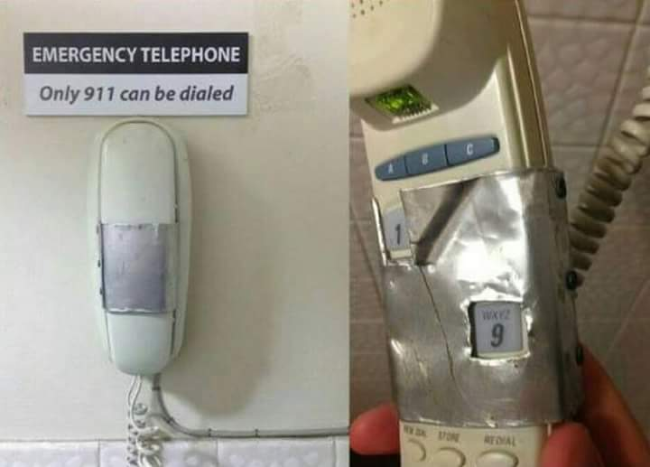
Validate Inputs (Sinks)
Notes:
Here’s why it’s important to validate on the server side
By all means do clientside validation but understand that it should only be syntactic sugar for UX and nothing more.
This is because form submissions can be manipulated beyond the point the browser has enforced its client-side checks.
Or the checks on the client side can be bypassed altogether.

Slide 12
Validate Inputs (Sinks)
<script>alert('xss')</script>
%3c%73%63%72%69%70%74%3e%61%6c%65%72%74%28%27%78%73%73%27%29%3c%2f%73%63%72%69%70%74%3e
&#x3c;&#x73;&#x63;&#x72;&#x69;&#x70;&#x74;&#x3e;&#x61;&#x6c;&#x65;&#x72;&#x74;&#x28;&#x27;&#x78;&#x73;&#x73;&#x27;&#x29;&#x3c;&#x2f;&#x73;&#x63;&#x72;&#x69;&#x70;&#x74;&#x3e;
Notes:
One thing to note with validation – take great care when deciding what not to allow.
These three strings all say the same thing to a browser engine.
<explain them>
URL encoded
HTML encoded
You might also face hex encoding or some other content type

Slide 13
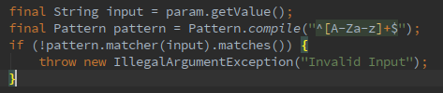
Validate Inputs (Sinks)
Notes:
One way to validate input is to use Regular Expressions.
In Java, compile a Pattern and use it to enforce a match. If the input doesn’t fit, get out of there!

Slide 14
Encode Outputs (Sources)
Just like Cryptography, you’re likely to get this wrong rolling your own
<script>alert('xss')</script>
<scri<script>pt>alert('xss');</scr</script>ipt>
<img src=alert(‘xss’) />
Notes:
An output is anything that has come from an untrusted source and you’re either passing along or taking responsibility for displaying.
This is the super important bit
Just like crypto, this is a lot harder than you think to do right and someone’s already doing it better and offering it as a library.
The STK here proposes ESAPI but OWASP have the Java Encoder Project that supercedes ESAPI.
<in your browser>
<go through the example of why not to roll your own>
The important thing to understand is that context is everything here.
You can’t just encode everything in a blanket fashion and be done.
You might even encode the same bit of data two different ways for two different contexts, if, for instance, it’s used both in dynamic CSS generation and within the body of your html.
You have to understand where your data’s going to be used and act accordingly. Encoding is performed at the point you’re presenting the data.

Slide 15
Encode Outputs (Sources)
Potential scripts become strings, but...
Ensure you encode for the right output!
String safe =
Encode.forHTML( param.value );
Encode.forURL( param.value );
Encode.forCSS( param.value );
Encode.forJS( param.value );
<script> becomes &lt;script&gt; and renders as <script>
Verbatim, rather than opening a script tag
Notes:
Done correctly, <script> becomes &lt;script&gt; in the markup and a harmless, verbatim “<script>” string in the browser rather than the opening of a tag.
Choose the project for your language:
ESAPI but support is dwindling
OWASP Java Encoder Project
OWASP Java HTML Sanitizer Project
AntiSamy

Slide 16
Other good practice
Secure HttpOnly Cookies
Expire your cookies
Set Content Security Policies (CSP)
Tie sessions to IP
Notes:
There are other good practices too – even if your website is set to use HTTPS and transmit over a secure connection, unless you mark your cookies Secure, they can be later accessed still over HTTP.
And HTTPOnly – javscript rarely has any business dealing with cookies. The reason I was able to grab the one earlier is because HTTPOnly wasn’t set. That dictates that the cookie can only be given over as part of a page submission or request.
Expire your cookies – shorten the window as much as possible where an XSS assailant can steal a session in. Of course there’s a trade off here because you don’t want the legitimate user to have to keep logging back in.
Content Security Policies are a new thing. They’re a set of headers that define the only places scripts and css are allowed to come from.
If these were set, I wouldn’t have been allowed to run the XSS-Shake attack.
Lastly, when a user logs in, tie his IP address to his session. If he has all the right cookies but came from the wrong IP, destroy his session and kick him out! The legitimate user will be a bit confused but he’ll be safe

Slide 17
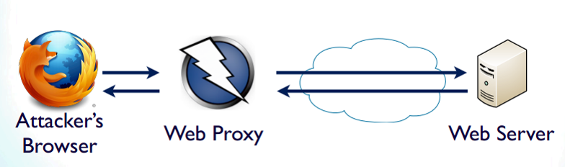
How to Test
Notes:
One way you can test, and I kind of alluded to this earlier, is with the help of an attack proxy. It’s a piece of software that sits between the client and the server intercepting all traffic between the two. That way you can manipulate to your heart’s content.
<show if we’ve got time>

Slide 18
Any Questions?

Slide 19
Notices
7th June – Test and secure an online Rubik’s Cube Solver – A Practical application of the topics covered today
22nd June – Global Hackathon – go/HackathonApp

